Slide 1
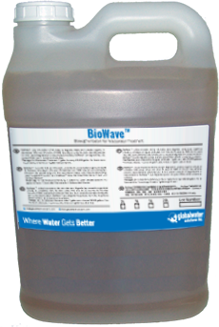
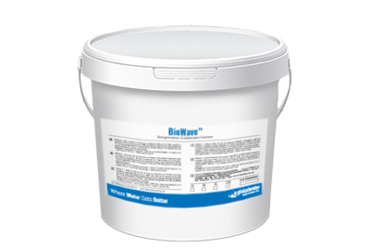
BioWaveTM
Waste Water Bioaugmentation Solution

Slide 2
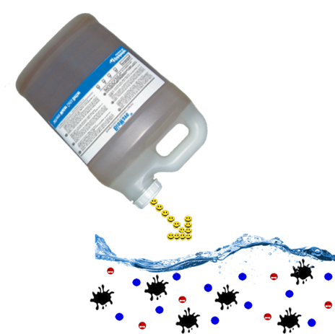
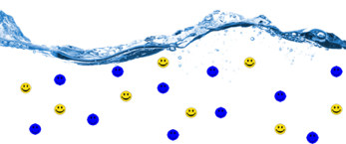
BioWaveTM
What is Bioaugmentation?
What is Bioaugmentation?
Product Overview
Product Features
Applications
Why use BioWaveTM
How does BioWaveTM work?
How is BioWaveTM applied?
Septic Systems
Grey Water
Ponds / Aquaria
Case Studies
Bioaugmentation is the process where beneficial microbes are added to waste water to enhance the existing microbial populations in order to breakdown and digest organic waste.

Slide 3
BioWaveTM
What is Bioaugmentation?
What is Bioaugmentation?
Product Overview
Product Features
Applications
Why use BioWaveTM
How does BioWaveTM work?
How is BioWaveTM applied?
Septic Systems
Grey Water
Ponds / Aquaria
Case Studies
Microbes don’t have mouths, but feed through their cell walls by secreting enzymes into the water. These secretions are the key to breaking down and digesting the organic and inorganic matter.

Slide 4
BioWaveTM
What products are included in the BioWaveTM Series?
What is Bioaugmentation?
Product Overview
Product Features
Applications
Why use BioWaveTM
How does BioWaveTM work?
How is BioWaveTM applied?
Septic Systems
Grey Water
Ponds / Aquaria
Case Studies
BioWaveTM
Beneficial microbe liquid solution for specialized wastewater organics degradation, grease control, odor reduction, water clarity enhancement, and biological treatment of ponds and waste water systems

Slide 5
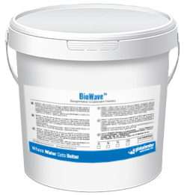
BioWaveTM
What products are included in the BioWaveTM Series?
What is Bioaugmentation?
Product Overview
Product Features
Applications
Why use BioWaveTM
How does BioWaveTM work?
How is BioWaveTM applied?
Septic Systems
Grey Water
Ponds / Aquaria
Case Studies
BioPelletsTM
Beneficial microbe inoculated pellets designed for enhanced odor and sludge reduction in grey water and waste water treatment systems

Slide 6
BioWaveTM
What are the main features of BioWaveTM?
What is Bioaugmentation?
Product Overview
Product Features
Applications
Why use BioWaveTM
How does BioWaveTM work?
How is BioWaveTM applied?
Septic Systems
Grey Water
Ponds / Aquaria
Case Studies
Microbe Strains are all Derived Naturally from the Earth
Not Genetically Modified
All-Star Teams of Carefully Selected Bacteria, Yeast, and Fungal Strains
Extremely High Concentrations Levels
Able To Perform Both Aerobically and in Low Oxygen Environments
Non-Pathogenic
Easily to Apply - Pourable Liquid or Slow Release Pellets
Able to Digest FOG (Fats, Oils & Grease)

Slide 7
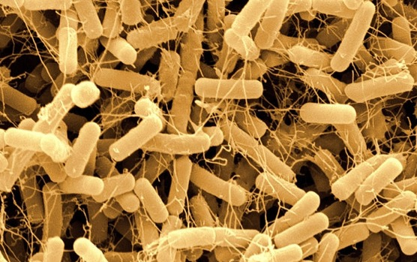
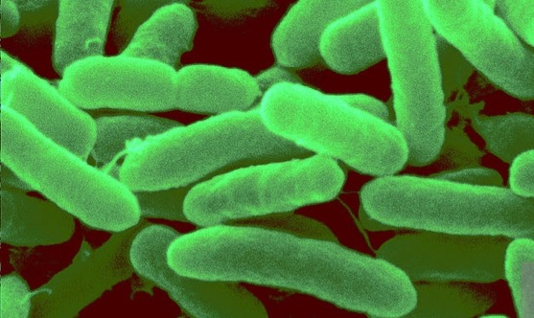
BioWaveTM
What are the main features of BioWaveTM?
What is Bioaugmentation?
Product Overview
Product Features
Applications
Why use BioWaveTM
How does BioWaveTM work?
How is BioWaveTM applied?
Septic Systems
Grey Water
Ponds / Aquaria
Case Studies
BioWave™ contains 100% naturally occurring microbes including:
Bacillus amyloliquefaciens, Bacillus licheniformis, Bacillus subtilis - Specialized in starch and protein degradation.
Pseudomonas - Specialized in lipid, starch and protein degradation.

Slide 8
BioWaveTM
What are the main features of BioWaveTM?
What is Bioaugmentation?
Product Overview
Product Features
Applications
Why use BioWaveTM
How does BioWaveTM work?
How is BioWaveTM applied?
Septic Systems
Grey Water
Ponds / Aquaria
Case Studies
Other specialized species - Specialized in cellulose, complex polymer and
simple sugar breakdown, ammonia, hydrogen sulfide degradation and denitrification. The microbes use enzymes to degrade these into harmless byproducts which become food for the microbes themselves.

Slide 9
BioWaveTM
Suitable Applications
What is Bioaugmentation?
Product Overview
Product Features
Applications
Why use BioWaveTM
How does BioWaveTM work?
How is BioWaveTM applied?
Septic Systems
Grey Water
Ponds / Aquaria
Case Studies
Waste Water Treatment Plants
Home Owners with Septic Systems and/or Grey Water Recycling Systems
Restaurants, Bakeries, Food Processing Facilities, Wineries & Breweries
Farms, Nurseries, Vegetable Processing Plants
Dairies, Abattoirs, Feedlots, Meat Packing Facilities
Commercial Composting Operators
Aquatic Ponds, Ornamental Ponds, Aquaculture Operators
Paper and Textile Mills, Refineries, Chemical Plants, Tanneries, Steel Mills

Slide 10
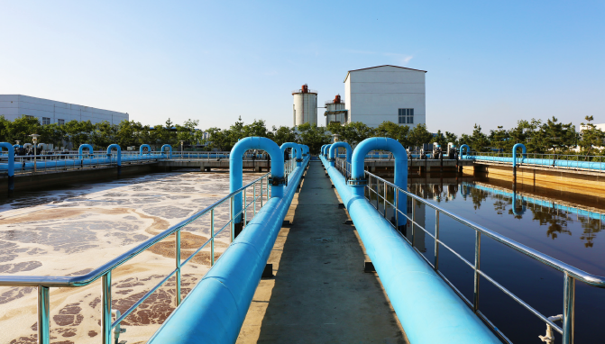
BioWaveTM
Why use BioWaveTM in waste water treatment plants?
What is Bioaugmentation?
Product Overview
Product Features
Applications
Why use BioWaveTM
How does BioWaveTM work?
How is BioWaveTM applied?
Septic Systems
Grey Water
Ponds / Aquaria
Case Studies
Overloaded facilities due to increased infrastructure and human settlement leading to clogged systems
Fouling of downstream maturation ponds
Equipment failures, such as aerators and belt presses
Load shedding resulting in plant sludge settling and suspended clarifier carry-over to the down stream system

Slide 11
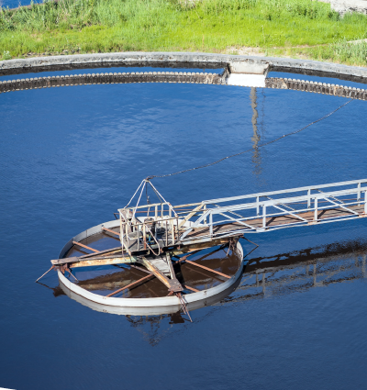
BioWaveTM
Why use BioWaveTM in waste water treatment plants?
What is Bioaugmentation?
Product Overview
Product Features
Applications
Why use BioWaveTM
How does BioWaveTM work?
How is BioWaveTM applied?
Septic Systems
Grey Water
Ponds / Aquaria
Case Studies
Dumping of waste by users (chlorine, anti-bacterial chemicals) that kill off or harm existing microbe populations needed to reduce BOD.
Discharge by users of high COD producing waste
Overloading of plants caused by misdirected storm water leading to dilution and havoc at the WWTW facility

Slide 12
BioWaveTM
How does BioWaveTM work in waste water treatment plants?
What is Bioaugmentation?
Product Overview
Product Features
Applications
Why use BioWaveTM
How does BioWaveTM work?
How is BioWaveTM applied?
Septic Systems
Grey Water
Ponds / Aquaria
Case Studies
Reduces the BOD, COD, sludge, grease and hydrogen sulfide in wastewater treatment and collection systems
Increases and improves removal of TSS, resulting in reduced sludge production; also reduces odor and maintenance required in pumping stations
Reduces maintenance through reduction of grease in lines & traps
Degrades carbohydrates, proteins and lipids while metabolizing various forms of inorganic nitrogen
Degrades complex polymers such as cellulose, chitin, and their intermediates and related compounds

Slide 13
BioWaveTM
How is BioWaveTM applied in waste water treatment plants?
What is Bioaugmentation?
Product Overview
Product Features
Applications
Why use BioWaveTM
How does BioWaveTM work?
How is BioWaveTM applied?
Septic Systems
Grey Water
Ponds / Aquaria
Case Studies
BioWave is normally added in at the aerator basin early In the process. A bottle or jug is simply opened and poured in, meaning no need for oxygenators. This dosing is done by the process controller and is strictly managed
Adding to the aerator ensures the microbes immediately find food and oxygen and start feeding, breeding and multiplying
This multiplying effect carries over to the clarifiers and maturation system as well as accompanying the return active sludge back into the plant’s infeed zone
Dilution will occur over time requiring additional doses to be added at regular intervals (See Dosing Guidelines)

Slide 14
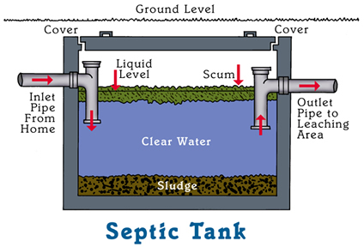
BioWaveTM
BioWaveTM – An Ideal Solution for Septic Systems
What is Bioaugmentation?
Product Overview
Product Features
Applications
Why use BioWaveTM
How does BioWaveTM work?
How is BioWaveTM applied?
Septic Systems
Grey Water
Ponds / Aquaria
Case Studies
BioWaveTM also works to biodegrade fats, oils, and grease trapped in the scum layer of the septic tank, extending the life of
the septic tank and drain field, reducing the time between pump outs, and reducing outflow pipe backups.

Slide 15
BioWaveTM
BioWaveTM – An Ideal Solution for Septic Systems
What is Bioaugmentation?
Product Overview
Product Features
Applications
Why use BioWaveTM
How does BioWaveTM work?
How is BioWaveTM applied?
Septic Systems
Grey Water
Ponds / Aquaria
Case Studies
While treating the scum layer, BioWaveTM microbes will will also reduce heavier solids in household wastewater that
settle in the sludge layer. They will even travel to the drain field and continue their degradation abilities.

Slide 16
BioWaveTM
BioWaveTM – An Ideal Solution for Grey Water Recycling Systems
What is Bioaugmentation?
Product Overview
Product Features
Applications
Why use BioWaveTM
How does BioWaveTM work?
How is BioWaveTM applied?
Septic Systems
Grey Water
Ponds / Aquaria
Case Studies
BioPelletsTM are an ideal solution for grey water collection and recycling systems. The slow release pellets provide billions of natural microbes that compete with and reduce bacteria colonies that emit H₂S gas, thus reducing odor while degrading organic solids and improving water quality.
Each bucket contains 2 x 250g doses.

Slide 17
BioWaveTM
BioWaveTM – Biological Pond/ Aquaria / Aquaculture Treatment
What is Bioaugmentation?
Product Overview
Product Features
Applications
Why use BioWaveTM
How does BioWaveTM work?
How is BioWaveTM applied?
Septic Systems
Grey Water
Ponds / Aquaria
Case Studies
Keeps ponds / aquaria clean & clear
Reduces noxious odors due to dead algae, fish fecal matter and urine
Improves dissolved oxygen levels and dissolves away organic sediment
Reduces muck and sludge build-up from organic decay
Breaks down & eliminates animal waste
Eliminates murky water from organic waste
Reduces toxic ammonia from pond water
Significantly Reduces problem causing nitrate & phosphate

Slide 18
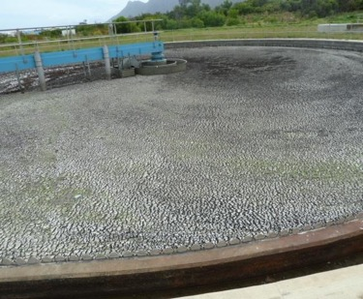
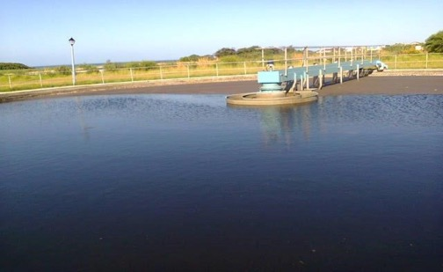
BioWaveTM
Case Studies
What is Bioaugmentation?
Product Overview
Product Features
Applications
Why use BioWaveTM
How does BioWaveTM work?
How is BioWaveTM applied?
Septic Systems
Grey Water
Ponds / Aquaria
Case Studies
Before
After
Blocked Clarifier: Cleared After 5 Days

Slide 19
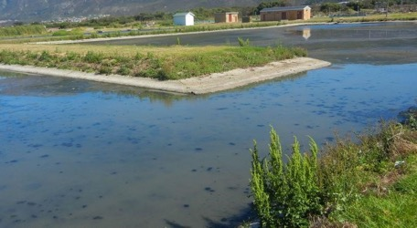
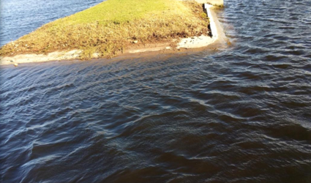
BioWaveTM
Case Studies
What is Bioaugmentation?
Product Overview
Product Features
Applications
Why use BioWaveTM
How does BioWaveTM work?
How is BioWaveTM applied?
Septic Systems
Grey Water
Ponds / Aquaria
Case Studies
Before
After
Fouled Maturation Pond: Completely cleared in 2 months and remained so for over 6 months

Slide 20
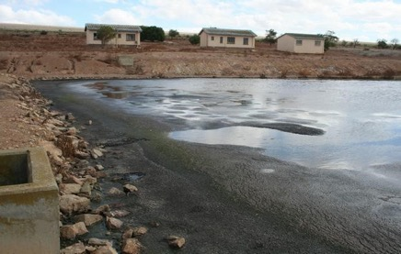
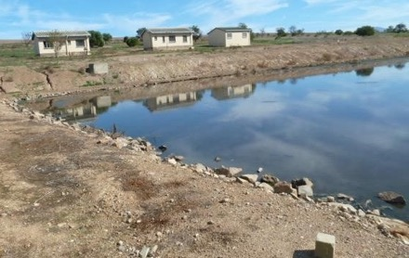
BioWaveTM
Case Studies
What is Bioaugmentation?
Product Overview
Product Features
Applications
Why use BioWaveTM
How does BioWaveTM work?
How is BioWaveTM applied?
Septic Systems
Grey Water
Ponds / Aquaria
Case Studies
Before
After
Customer’s outcome after 49 days

Slide 21
BioWaveTM
Case Studies
What is Bioaugmentation?
Product Overview
Product Features
Applications
Why use BioWaveTM
How does BioWaveTM work?
How is BioWaveTM applied?
Septic Systems
Grey Water
Ponds / Aquaria
Case Studies
Case Study #1: Potato Chip Manufacturing Facility (24 hr retention time)
Before Treatment:
TSS – 27,220 mg/L
BOD – 6,480 mg/L
After Treatment:
TSS – 5,960 mg/L
BOD – 558 mg/L
Case Study #2: Ice Cream Production Facility (24 hr retention time)
Before Treatment:
TSS – 2,350 mg/L
BOD – 8,380 mg/L
After Treatment:
TSS – 576 mg/L
BOD – 3,570 mg/L

Slide 22
BioWaveTM
Case Studies
What is Bioaugmentation?
Product Overview
Product Features
Applications
Why use BioWaveTM
How does BioWaveTM work?
How is BioWaveTM applied?
Septic Systems
Grey Water
Ponds / Aquaria
Case Studies
Case Study #3: Meat Processing Facility #1 (18 hr retention time)
Before Treatment:
TSS – 619 mg/L
BOD – 690 mg/L
Oil & Grease – 120 mg/L
After Treatment:
TSS – 32 mg/L
BOD – 612 mg/L
Oil & Grease – 10 mg/L*
*Grease trap went from being cleaned twice per week to twice per month

Slide 23
BioWaveTM
Case Studies
What is Bioaugmentation?
Product Overview
Product Features
Applications
Why use BioWaveTM
How does BioWaveTM work?
How is BioWaveTM applied?
Septic Systems
Grey Water
Ponds / Aquaria
Case Studies
Case Study #4: Meat Processing Facility #2 (6 hr retention time)
Before Treatment:
TSS – 680 mg/L
BOD – 1,200 mg/L
Oil & Grease – 105 mg/L
After Treatment:
TSS – 322 mg/L
BOD – 1,015mg/L
Oil & Grease – 62 mg/L
Case Study #5: Bakery (48 hr retention time)
Before Treatment:
Oil & Grease – 1,019 mg/L
After Treatment:
Oil & Grease – 62 mg/L

Slide 24
BioWaveTM
Case Studies
What is Bioaugmentation?
Product Overview
Product Features
Applications
Why use BioWaveTM
How does BioWaveTM work?
How is BioWaveTM applied?
Septic Systems
Grey Water
Ponds / Aquaria
Case Studies
Case Study #6: Crude Oil Refinery (8 hr retention time)
Before Treatment:
Phenol – 20 ppm
Oil & Grease – 15 mg/L
Ave. Clarifier Sludge Level – 12”
After Treatment:
Phenol – 1 ppm
Oil & Grease – 1 mg/L
Ave. Clarifier Sludge Level – 4”
Notes:
Experienced pop-ups in settling lagoons for 2 weeks
67% solids reduction based on volume

Slide 25
BioWaveTM
Case Studies
What is Bioaugmentation?
Product Overview
Product Features
Applications
Why use BioWaveTM
How does BioWaveTM work?
How is BioWaveTM applied?
Septic Systems
Grey Water
Ponds / Aquaria
Case Studies
Case Study #7: Municipal Lift Station (8 hr retention time)
Before Treatment:
3’ Solid Grease Blanket
Lift station Cleaned Every 90 Days
After 7 Months of Treatment:
Grease Reduced to 3 - 4” Soft Blanket
No Cleaning Required for 7 months
Case Study #8: Hazardous Waste Tank (No Flow)
After Treatment:
20% Sludge Reduction After 2 Months
99% Reduction of Chlorinated Solvents in Water

